Slide 1
Session 5
Methods of Teaching ELLs

Slide 7
Reading Strategies
for English Language Learners

Slide 12
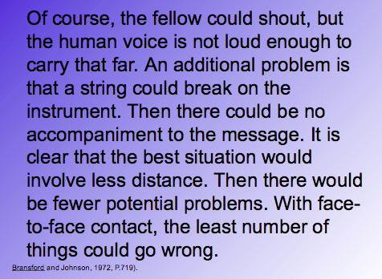

Slide 13
Typical Classroom Assessment
What would happen if the balloon popped?
Why would a closed window prevent the sound from carrying?
The entire operation is dependent on what?
Describe the complications caused by the broken string?
How would you prevent most of the problems?
What is the main idea of the passage?

Slide 14
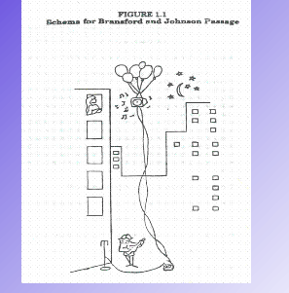

Slide 15
You’ve just experienced what it is like to be an English Language Learner in a classroom that does not shelter instruction.

Slide 16
Vocabulary Instruction
“Writers fish for the right words like fishermen fish for, um, whatever those aquatic creatures with fins and gills are called. ”
― Jarod Kintz, This is the best book I've ever written, and it still sucks

Slide 17
Marzano’s Six Step Process
Teaching Academic Vocabulary
https://docs.google.com/a/nssd112.org/spreadsheets/d/1IRYa7ahpXyOCgQ_4-TLJAshSICFbZDwJOiUYy1QGMtU/edit#gid=2105809245

Slide 18
Marzano’s Six Step Process
Teaching Academic Vocabulary
1. Provide a description, explanation, or example of the new term. (Include a non-linguistic representation of the term for ESL kids.)
2. Ask students to restate the description, explanation, or example in their own words or their L1.
3. Ask students to construct a picture, symbol, or graphic representing the word.
4. Engage students periodically in activities that help them add to their knowledge of the terms in their notebooks.
5. Periodically ask students to discuss the terms with one another. (Allow in native language when appropriate)
6. Involve students periodically in games that allow them to play with terms.

Slide 19
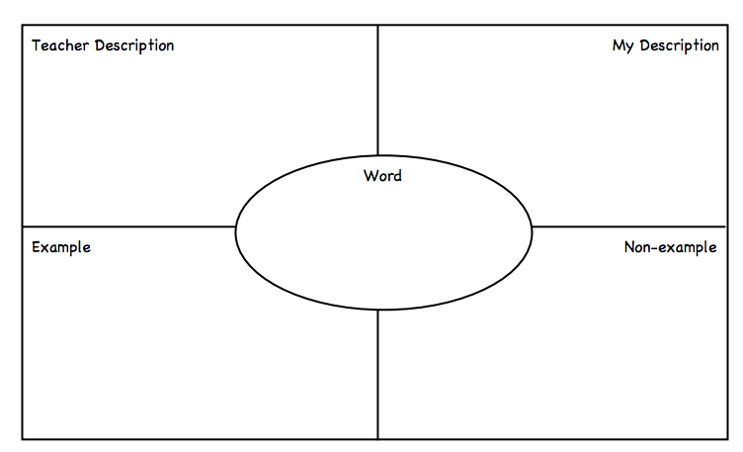

Slide 22
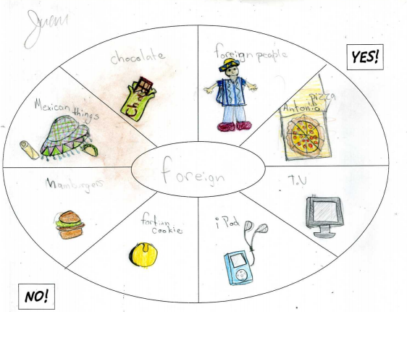

Slide 23
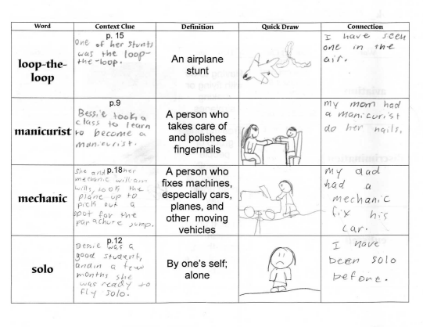

Slide 25
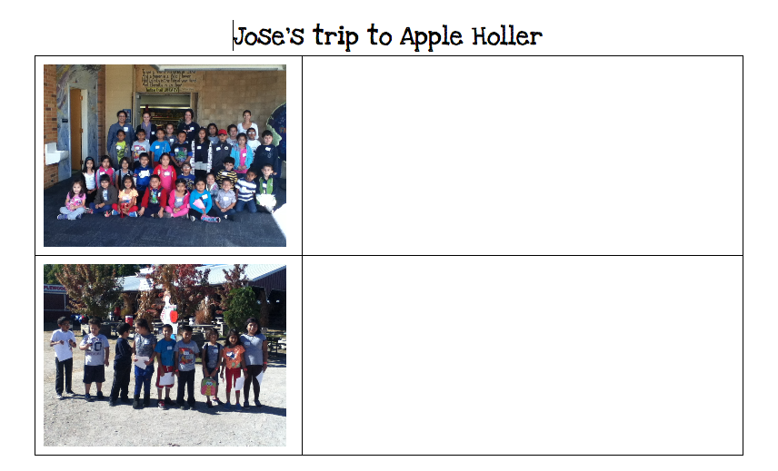
Language Experience Approach

Slide 27
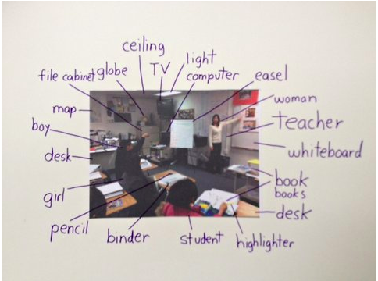
Picture Word Inductive Model

Slide 28
Total Physical Response
1. Students watch demonstration of key words and then a command using them.
2. Students listen again and watch as the teacher performs the action.
3. The teacher gives the command and models the action again, this time having
students perform the actions simultaneously.
4. The teacher gives the command to the group without modeling the action.
5. The teacher gives the command to an individual without modeling the action.
6. The teacher models variations & combinations for the groups.
7. Students perform variations & combinations.
8. If some students are ready, they give commands to classmates.

Slide 29
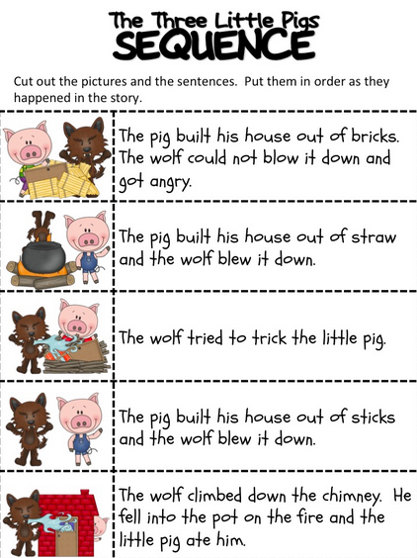
Summary with Illustrations
Sequence Sorts

Slide 30
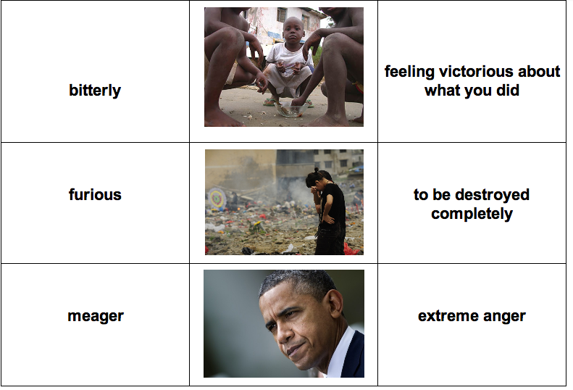
Vocabulary Sorts
Vocabulary Sorts/Previewing Vocabulary

Slide 31
Visually Preview Chapters
Visually Preview Chapters

Slide 33
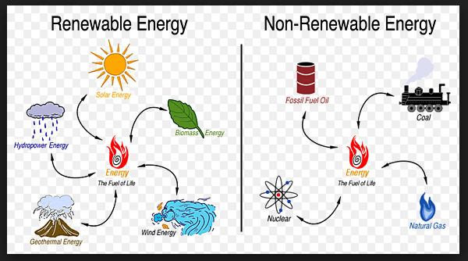

Slide 34
Connect Two
Connect Two

Slide 35
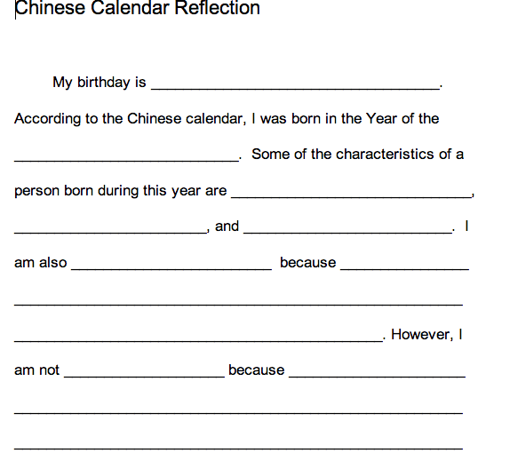
Paragraph Frames

Slide 36
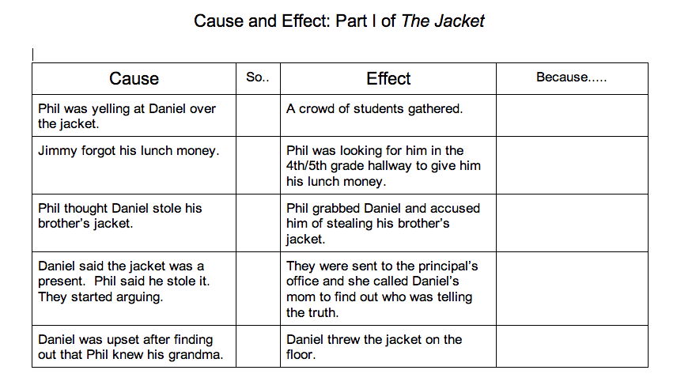
Scaffolding Activities

Slide 37
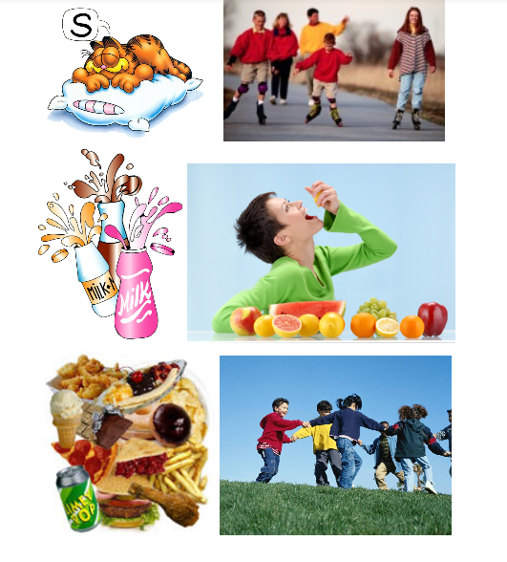
Concept Sort

Slide 38
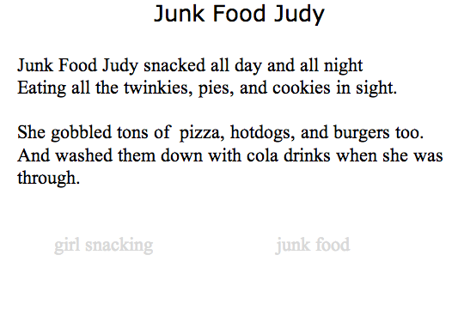
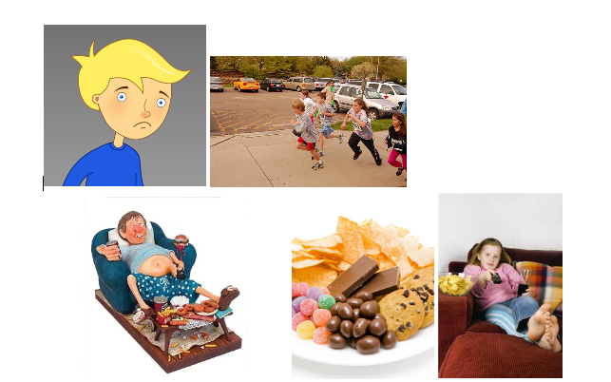
Illustrating Texts

Slide 39
Sample Lesson Cycle
https://docs.google.com/a/nssd112.org/document/d/1Lw04W1IzIiw_auSvDEiJ0i00BmgtnNbp25Rv5K_F8VQ/edit

Slide 40
Videos:
Background Knowledge
Scaffolding Instruction
Vocabulary Development
Jigsaw

