Slide 1
Session 2
Methods and Materials for Teaching English Language Learners

Slide 2
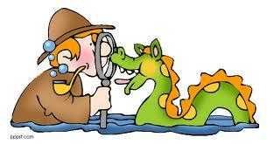
Myths
of Second Language Acquisition
Take the test. Answer to the best of your ability.

Slide 3
Adults learn second languages more easily than young children.

Slide 4
Adults learn second languages more easily than young children.
TRUE. This question is more complex than it seems. In controlled research where children have been compared to adults and teenagers in second language learning, it was found that the adults and teenagers learned a second language more readily.

Slide 5
According to research, students in ESL-only programs, with no
schooling in their native language, take 7-10 years to reach grade level norms.

Slide 6
According to research, students in ESL-only programs, with no
schooling in their native language, take 7-10 years to reach grade level norms.
TRUE. In the Collier/Thomas studies it was found that
in U.S. schools where all instruction is given through the second language
(English), non-native speakers of English with no schooling in their first
language take 7-10 years or more to reach age and grade-level norms of
their native English-speaking peers. Immigrant students who have had 2-3
years of first language schooling in their home country before they come
to the U.S. take at least 5-7 years to reach typical native-speaker
performance. This pattern exists across many student groups, regardless
of the particular home language that students speak, country of origin,
socioeconomic status, and other student background variables.

Slide 7
A lot of immigrant children have learning disabilities,not language problems. They speak English just fine but they are still failing academically.

Slide 8
A lot of immigrant children have learning disabilities,not language problems. They speak English just fine but they are still failing academically.
FALSE. We often see children on the playground who appear to speak English with no problem. Yet when they are in a classroom situation, they just don't seem to grasp the concepts. Many people fail to realize that there are different levels of language proficiency. Many immigrant children have been misdiagnosed in the past as "learning disabled," when in fact the problem was that people misunderstood their fluency on the playground, thinking that it meant they should be able to perform in class as well. Actually, they still needed time and assistance to develop their academic English skills (Cummins, 1994).

Slide 9
Older generations of immigrants learned without all the special language programs that immigrant children receive now. It was "sink or swim" and they did just fine!

Slide 10
Second language learners will acquire academic English faster if their parents speak English at home.

Slide 11
Second language learners will acquire academic English faster if their parents speak English at home.
FALSE. Research shows that it is much better for parents to speak in native language to their children. This language will be richer and more complex. It doesn’t matter in what language basic concepts are developed. Children will eventually translate that learning to English. So if a child is being read to in native language, parents will spend more time discussing the story, and asking questions. Never instruct a parent to speak only English at home. If you were in Japan, would you be able to speak only Japanese to your own children after a few months?

Slide 12
The more time students spend soaking up English in the mainstream classroom, the more quickly they will learn the language.

Slide 13
The more time students spend soaking up English in the mainstream classroom, the more quickly they will learn the language.
FALSE. Children need comprehensible input. Imagine that you
are sitting in a room of Japanese speakers. You have no idea what they
are talking about. You could sit there for a long time and learn very little
unless someone helped make that input comprehensible. Language is not
“soaked up.”

Slide 14
Once students can speak English, they are ready to undertake the academic tasks of the mainstream classroom.

Slide 15
Once students can speak English, they are ready to undertake the academic tasks of the mainstream classroom.
FALSE. Children can speak and socialize way before they can use language for academic purposes. BICS (Basic Interpersonal Communication Skills) are acquired first. This is social language such as the language needed to interact on the playground and in the classroom. It usually takes students from 1-3 years to completely develop this social language. Then children will develop CALP (Cognitive Academic Language Proficiency) skills. This is the language needed to undertake academic tasks in the mainstream classroom. It includes content-specific vocabulary. It usually takes students from 3 to 7 years or longer to develop CALP.

Slide 16
Cognitive and academic development in native language has an important and positive effect on second language acquisition.

Slide 17
Cognitive and academic development in native language has an important and positive effect on second language acquisition.
TRUE. In the Collier/Thomas examination of large data sets across many different research sites, they found that the most significant student background variable is the amount of formal schooling students have received in their first language. Across all program treatments, we have found that non-native speakers being schooled in a second language for part or all of the school day typically do reasonably well in the early years of schooling (kindergarten through second or third grade). But from fourth grade on through middle school and high school, when the academic and cognitive demands of the curriculum increase rapidly with each succeeding year, students with little or no academic and cognitive development in their first language do less and less well as they move into the upper grades.

Slide 18
The culture of students doesn’t affect how long it takes them to acquire English. All students learn language the same way.

Slide 19
The culture of students doesn’t affect how long it takes them to acquire English. All students learn language the same way.
FALSE. Culture can affect how long it takes children learn English. Do your students come from a modern industrialized countries or a rural agricultural societies? Do your students come from language backgrounds using a different writing system? These factors will affect how long it takes them to learn English. Previous schooling and school expectations will also affect language learning. Also, the more culture shock experience

Slide 20
Chapter 1 and 2 Vocabulary/Picture Sort

Slide 30
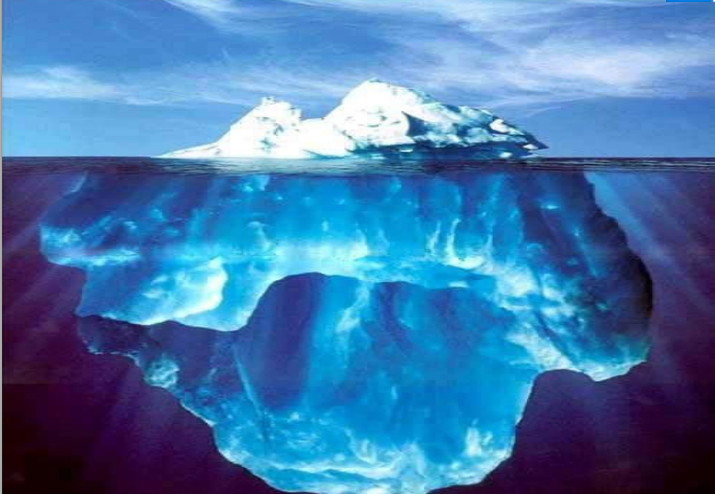

Slide 31
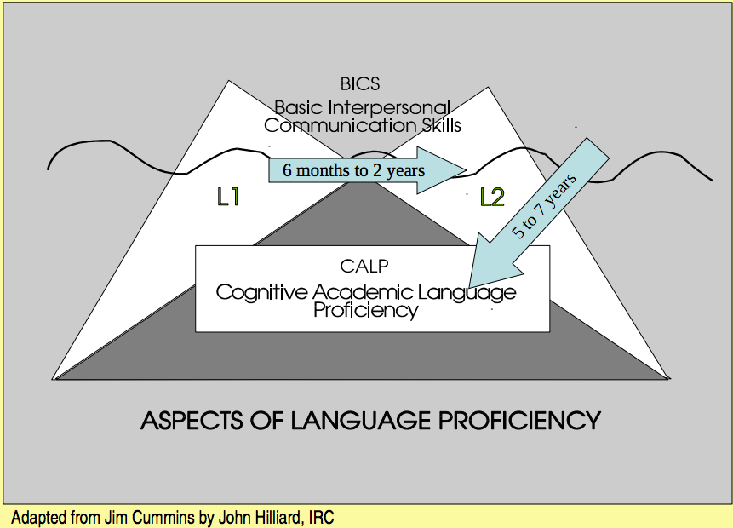

Slide 33
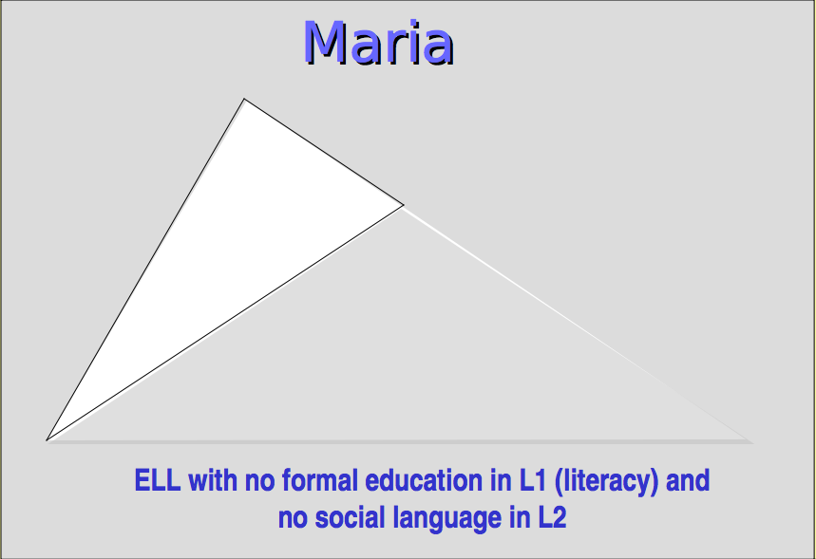

Slide 35
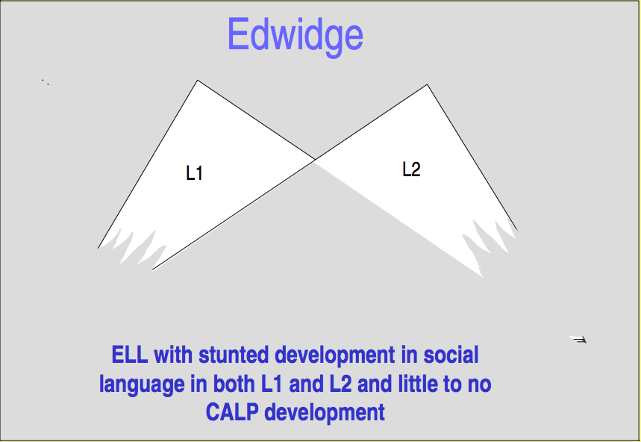

Slide 36
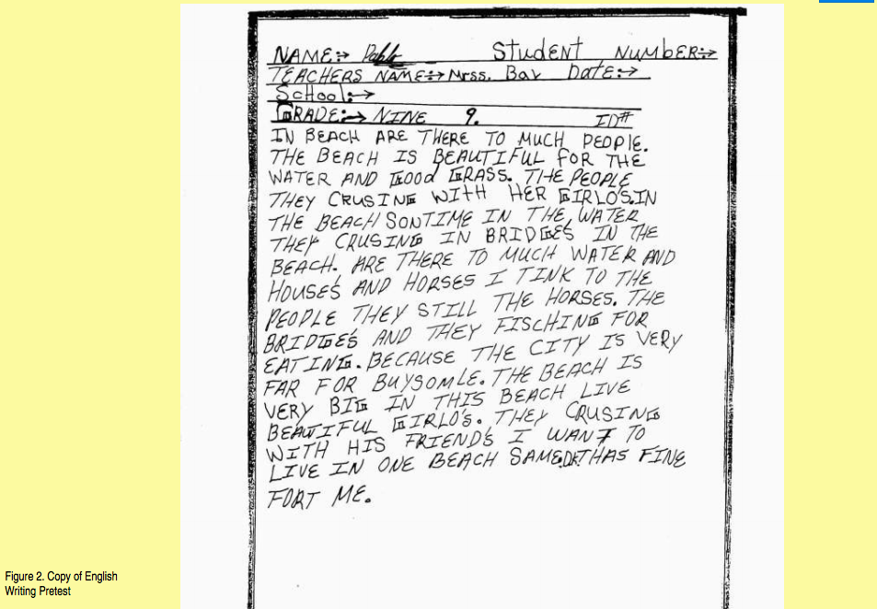
FIRST IMPRESSIONS?

Slide 37
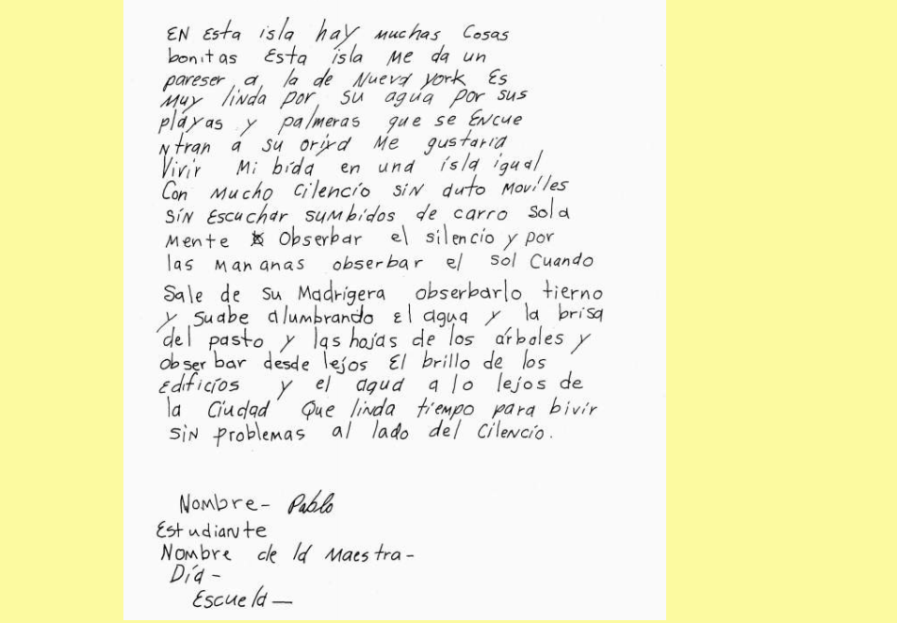

Slide 38
1. On this island there are many beautiful things
2. This island reminds me of that of New York’s
3. It is beautiful because of its beaches and palm trees that can be found along its shore
4. I would love to spend my life on an island like this one with much silence, without automobiles, without the zooming of cars…only to observe the silence
5. And in the morning watch the sun as it rises at dawn
6. Observe it tenderly and smoothly as it illuminates the water and feel the breeze from the grass and the leaves on the trees
7. And observe from afar the sparkle of the building and the water beyond the city

Slide 40
Sentence starters/frames
• I learned that ______. I already knew ___.
• I didn’t realize that…
• _________ was surprising to me because…
• Learning about ________ gave me new insight because…
• ______ reminds me of…
• First I thought ____, but now I realize ...

Slide 41
How do we teach language?
Jigsaw
In groups, each person will read over his/her article and be able to fill in the following sentence frame:
“The ________approach is a method of teaching language where ______________. My experience with this approach is _________.”
Then each group member will teach the others about the language approach they read about.

Slide 44
SIOP
Sheltered Instruction Observation Protocol

Slide 49
Understanding by Design

Slide 55
Lesson Cycle
A combination of approaches

Slide 56
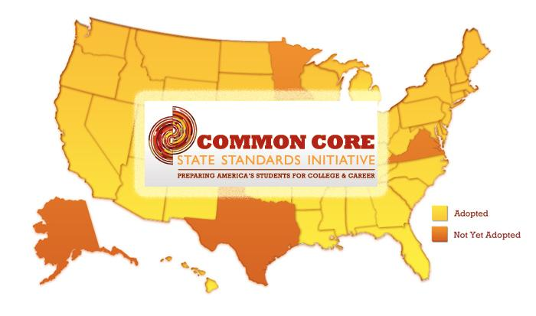
Identification of Big Ideas by Cheryl Urow
Start with your state standards.
As a public school teacher, your state
academic standards outline what you are
required to teach. And it is worth mentioning
here that a textbook or science
program is not a curriculum. A textbook or
packaged program is a resource for teaching either state standards or a local curriculum, but does not define the curriculum.

Slide 57
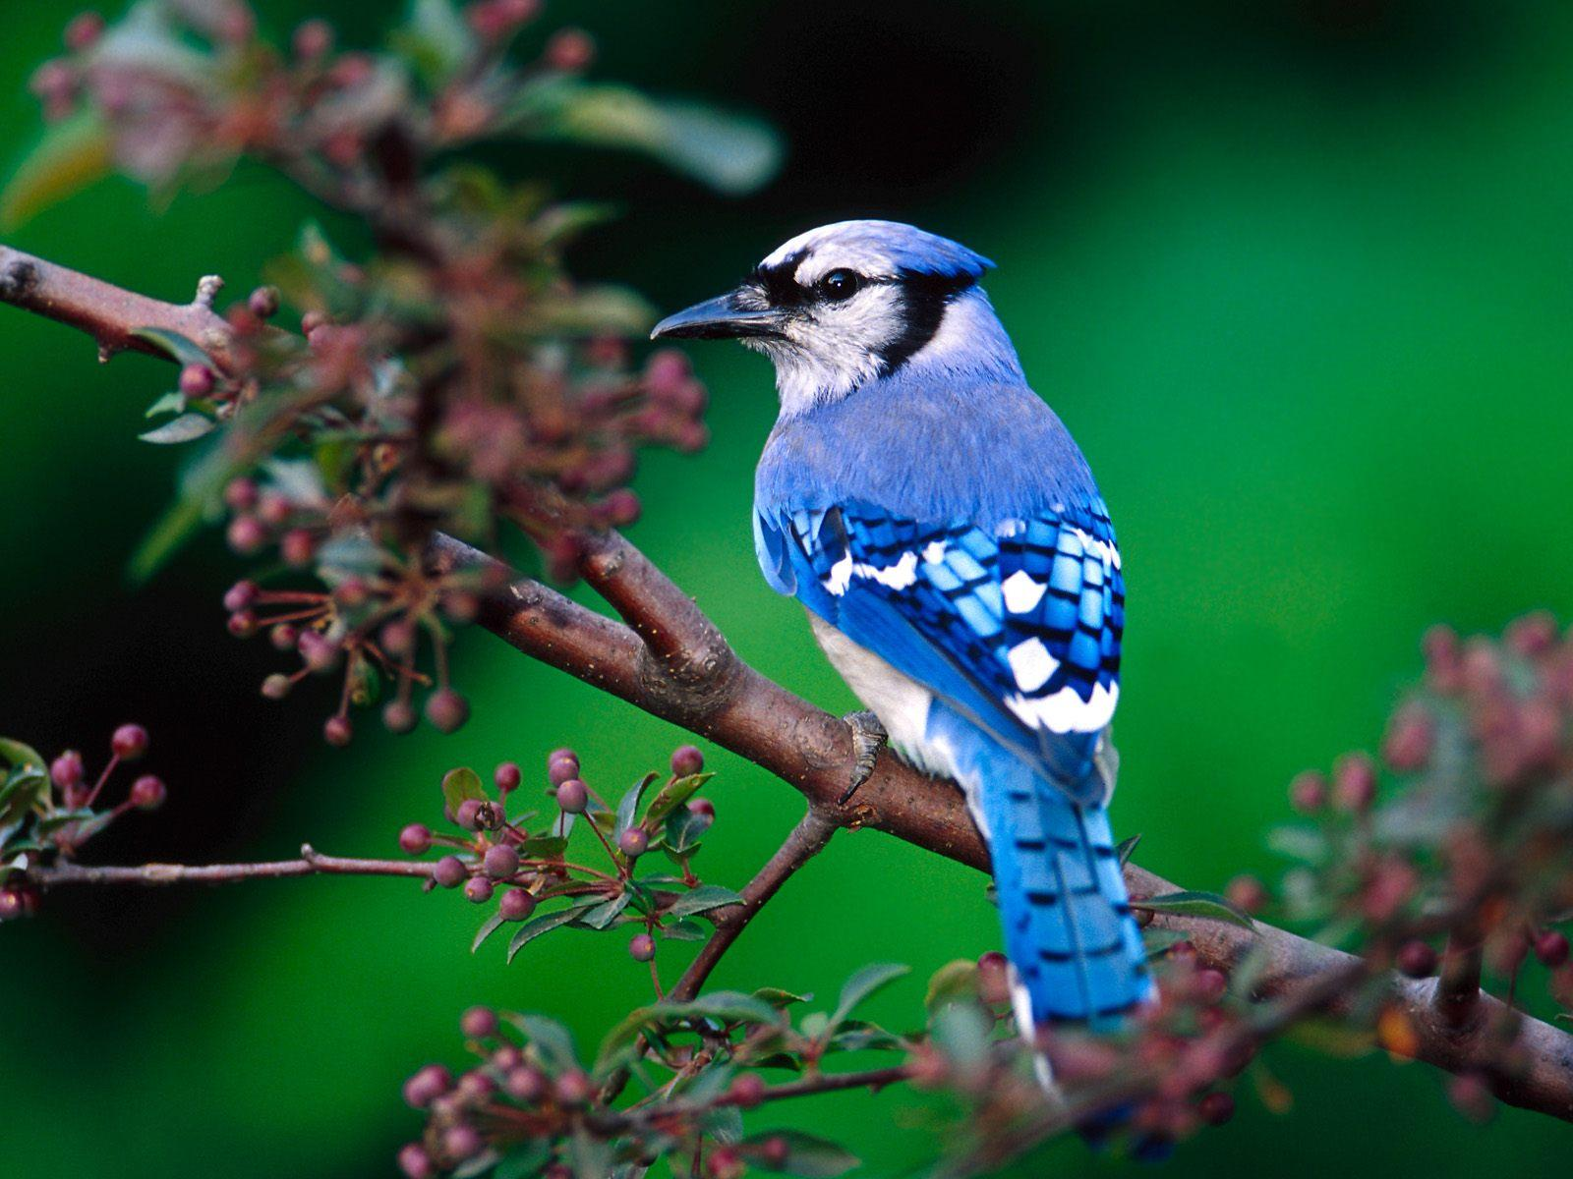
Example Topic: Life Cycles of Birds (2nd grade)

Slide 58
Step One: Ask yourself...
“Do my state standards mention learning about the life cycle of birds in second grade?”
State academic standards are not usually so specific. They usually point to more general knowledge, like “Describe simple life cycles of plants and animals and the similarities and differences in their offspring.” (This example was taken from the Illinois State Academic Standards.)

Slide 59
Step Two: Create a big idea.
Once you have made sure you are focusing on your state standards, you need to think about creating a big idea.
Big ideas, or essential understandings, outline what you want all students to know and understand when they complete the lesson cycle. Big ideas must be able to complete the sentence, “I want my students to understand that…”

Slide 60
What do we want our students to understand about life cycles?
“I want my student to understand that life cycles” is not a complete sentence.
BIG IDEA:
I want my students to understand that all living things have a life cycle.
BIG IDEA (for kinder or first grade):
I want my students to understand that all animals have a life cycle.

Slide 61
Step Three: Ask yourself, “Is this a big idea or a detail?”
To check if it is a big idea or detail, we see if we can give an example.
I want my students to understand that all living things have a life cycle.
For example, a bird begins life as an egg, then becomes a chick, then grows into a bird, and then lays an egg to begin the cycle again.
If you can give several examples of the big idea, it is indeed a big idea and not a detail.

Slide 62
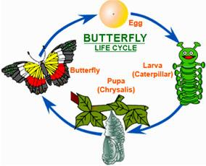
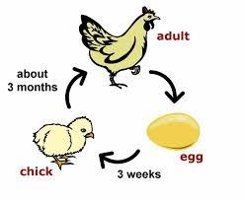
Multiple Examples
When we teach big ideas, we want to make sure to have students study several
examples of the big idea.
Life cycle of a bird
Life cycle of a human
Life cycle of a butterfly
When children are taught a big idea through one example only (only studying birds) they have a harder time generalizing their learning to other situations.

Slide 63
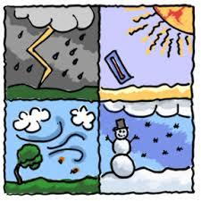
Example Topic: Climate

Slide 64
Step One: Ask yourself...
“Do my state standards mention learning about the weather or climate?”
Step Two: Create a big idea.
1. I want my students to understand that there are different types of climate in different places.
2. I want my students to understand that each climate
zone includes a variety of weather patterns.
Step Three: Big Idea or Detail?
1. For example, it is cold year round near the poles and warm year round near the equator.
2. For example, while it is always warm near the equator, it may be sunny
and warm or rainy and warm, depending on the season.

Slide 65
Big Idea or Detail?
I want my students to understand that the earth rotates on an axis and also circles the sun.
For example...

Slide 66
BIG IDEA: I want my students to understand that in our solar system, planets and moons move in two ways: rotation and revolution.
This would be the big idea if the lesson were focused on how things in space
move. By studying all planets and moons in our solar system (or at least
several, not just earth), students are brought to the deeper understanding that
this is how most things in our solar system move. It is not a detail, but a big
idea that is more widely applicable.

Slide 67
BIG IDEA: I want my students to understand that the rotation, revolution, and tilt of the earth affect the earth in specific ways.
This would be the big idea to use if the standards were more focused on how life on earth is affected by the rotation and revolution of the earth. And, if you are going to discuss how the earth’s revolution causes seasons, you need to teach students about the earth’s tilt.

Slide 68
So what?

Slide 69
So, in summary, developing a big idea follows these steps:
o Look at state standards or at a local curriculum
o Complete the sentence, “I want my students to understand that…”
o Decide if it is a big idea or detail by writing, “For example,…”
o Ask, “So what?”
o Make sure to plan activities that teach to your big idea

Slide 70
More examples
I want my students to understand that the American colonists obtained social, economic, and religious freedom from England through a great deal of struggle.
This is a great big idea as it is, but to make it even better, and to include the personal stories of the children, you might want to make it...
I want my students to understand that throughout history, many people have only obtained social, economic and religious freedom through struggle.

Slide 71
Big Ideas
I want my students to understand that geography affects the economic, social, and political development of communities.
I want my students to understand that people affect the environment and the environment affects people.
I want my students to understand that all materials can be classified as solids, liquids, or gases.
I want my students to understand that all matter is made up of small particles.

Slide 72
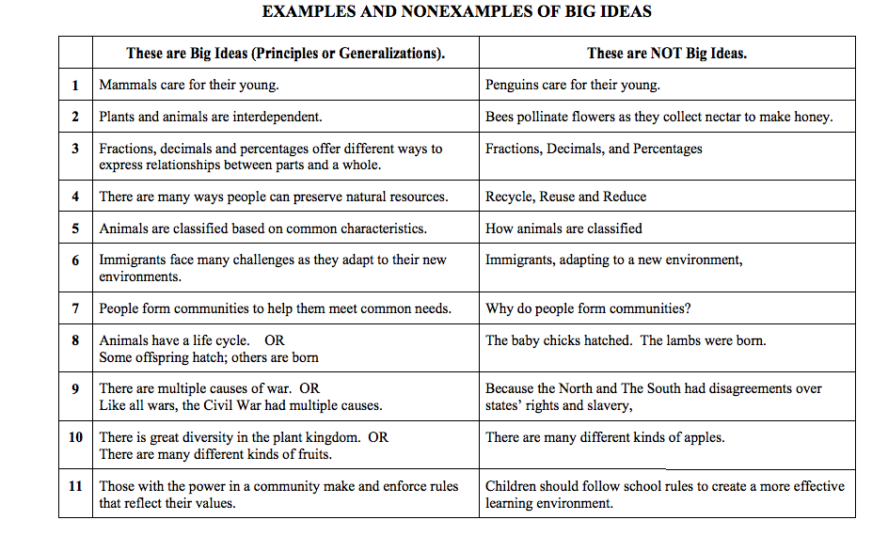
What is your definition of a Big Idea? Frayer Model

Slide 73
Common Core State Standard:
Grade Level:
WIDA Standard: Circle One
Language of Language Arts
Language of Science
Language of Social Studies
Language of Mathematics
Social and Instructional Language
Big Idea:
I want my students to understand that…
For example….
So what?

